Slide 1
18CSE390T
Computer Vision
S8-2D and 3D feature-based alignment

Slide 2
2D and 3D feature-based alignment
2D alignment using least squares
Given a set of matched feature points {(xi, x′i)} and a planar parametric transformation of the form
x′ = f (x; p),
How can we produce the best estimate of the motion paramethe
Use least squares, i.e., to minimize the sum of squared residuals

Slide 3
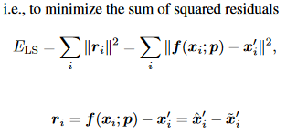
Least squares

Slide 4
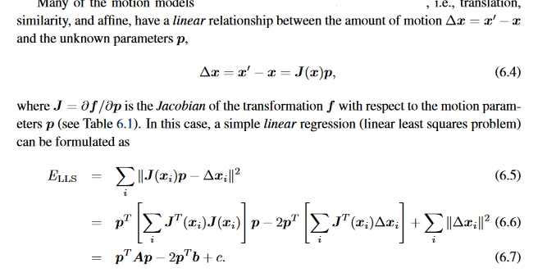

Slide 5
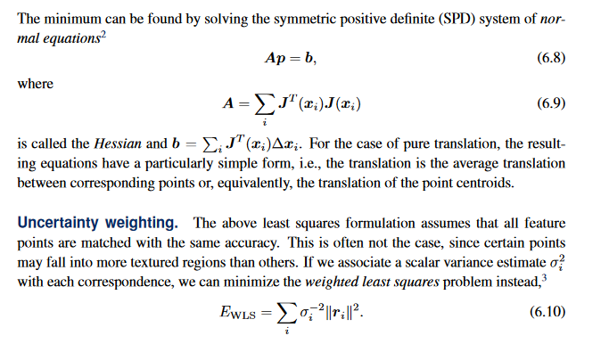
Uncertainty weighting

